Slide 1
FUTURE OF CHARITIES & TAX FUTURE PROSPECTS FOR CHARITY LAW, ACCOUNTING AND REGULATION CONFERENCE 2019
11 April 2019
Stewart .Donaldson @ird.govt.nz
https://www.ird.govt.nz/non-profit/np-updates/
Charities.Queries@ird.govt.nz

Slide 2
OVERVIEW
Government support the charitable sector through the tax system
Recent changes – context for the future
Tax Working Group recommendations
Other matters that have come to our attention
IR’s customer focus: let us know what you think

Slide 3
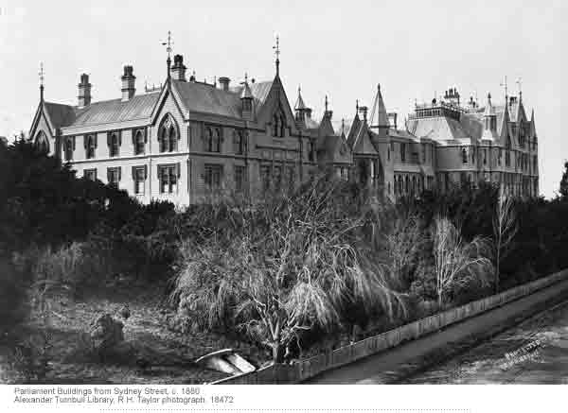
GOVERNMENT SUPPORT FOR THE CHARITABLE SECTOR THROUGH THE TAX SYSTEM
Income tax exemption
Resident Withholding Tax exemption
Donation concession
FBT exemption
GST concessions
Student Loan (interest-free) concession
Working for Families Tax Credit (charitable distribution) exclusion

Slide 4
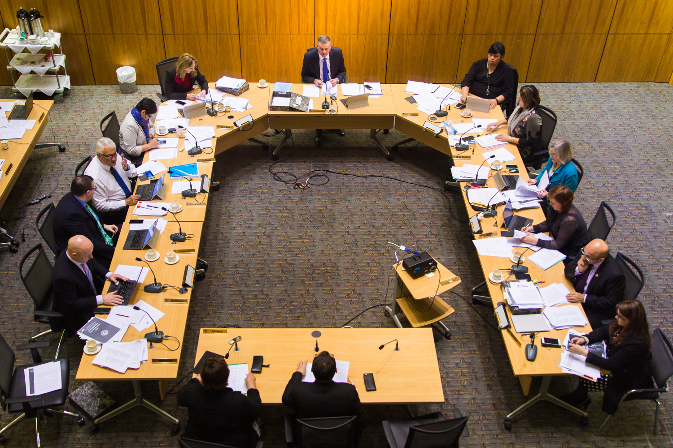
RECENT CHANGES – CONTEXT FOR THE FUTURE
Simplifying how to claim donation tax credits
Qualifying donations
Donee status rules
Deregistration rules
Business exemption rules
Honoraria / salary and wages (FENZ volunteers)
GST on assets sold

Slide 5
TAX WORKING GROUP RECOMMENDATIONS
Business income in the charitable sector
Charities that accumulate and do not distribute
Deregistration rules: keeping assets in the charitable sector in perpetuity
Better targeting other tax concessions: GST

Slide 6
OTHER MATTERS THAT HAVE COME TO OUR ATTENTION
Imputation credit refundability
The rise of social enterprises
Tax exemption for non-charitable purposes
Whether general tax concessions should be extended to charities
Donation tax concessions
Not-for-profits that are not tax exempt

Slide 7
IR’S CUSTOMER FOCUS: LET US KNOW YOUR EXPERIENCE
Email by 31 May 2019
Charities.queries@ird.govt.nz
Subject: Charity Insights
What is working well with Inland Revenue for your charity?
What could Inland Revenue improve (operationally or through recommending a law change) for your charity?

